Slide 1
Reconciliation through education Yes we can. Yes I will Professor Anita Heiss Wiradyuri Nation

Slide 3
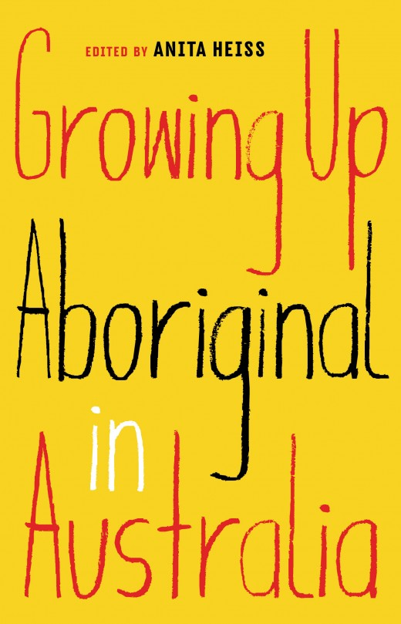
Susie & Alice Anderson
Evelyn Araluen
Bebe Backhouse
Alice Bates
Don Bemrose
Tony Birch
Norleen Brinkworth
Katie Bryan
Deborah Cheetham
Natalie Cromb
Karen Davis
Ian Dudley
Alice Eather
Shannon Foster
Jason Goninan
Adam Goodes
Jodi Haines
John Hartley
Terri Janke
Keira Jenkins
Patrick Johnson
Scott Kennedy
Sharon Kingaby
Jack Latimore
Miranda Tapsell
Ambelin Kwaymulllina
Jack Latimore
Celeste Liddle
Taryn Little
Matthew Lillyst
Amy McGuire
Melanie Mununggurr-Williams
Doreen Nelson
Sharon Payne
Zachary Penrith-Puchalski
Carol Petterson
Todd Phillips
Kerry Reed-Gilbert
William Russell
Marlee Silva
Liza-Mare Syron
Frank Szekely
Miranda Tapsell
Jared Thomas
Ceane G Towers
Aileen Walsh
Shahni Wellington
Alexis West
Alison Wittaker
John Williams-Mozley
Tara June Winch
Tamika Worrell

Slide 4
Audience:
Year levels: 9–12
Educators
Everyday readers
www.blackincbooks.com.au/books/growing-aboriginal-australia

Slide 5
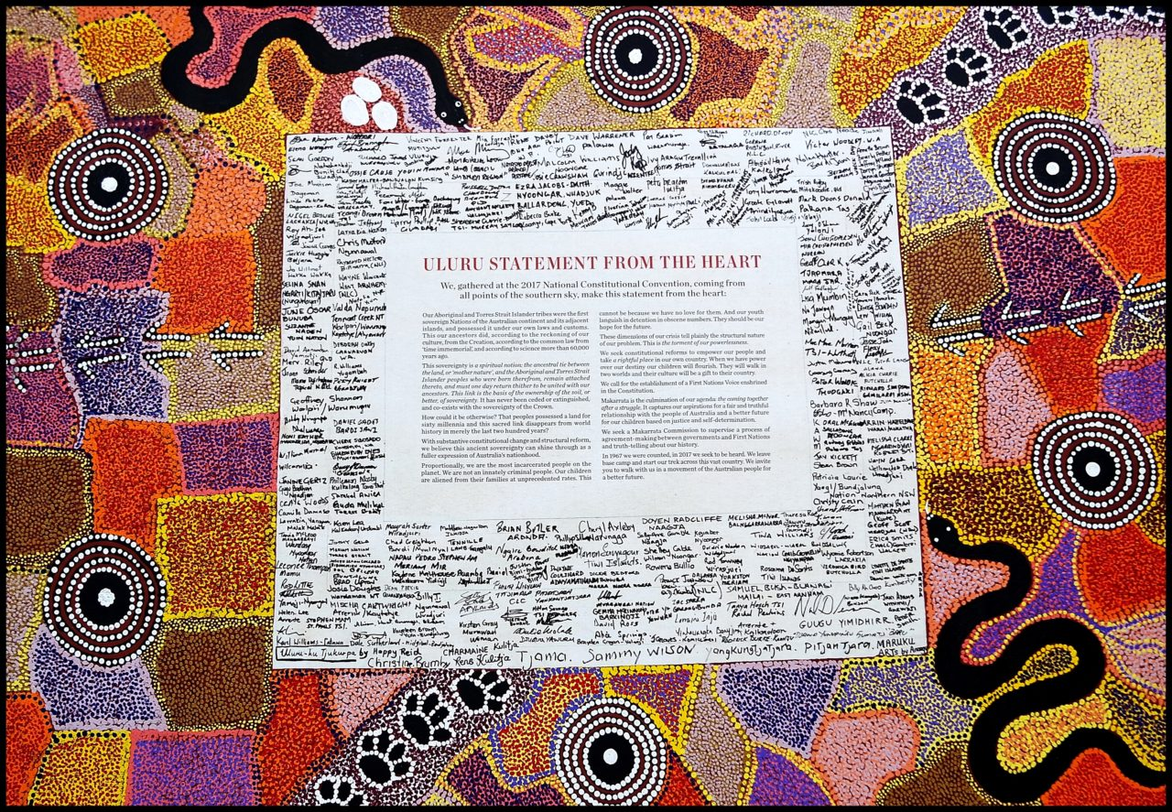
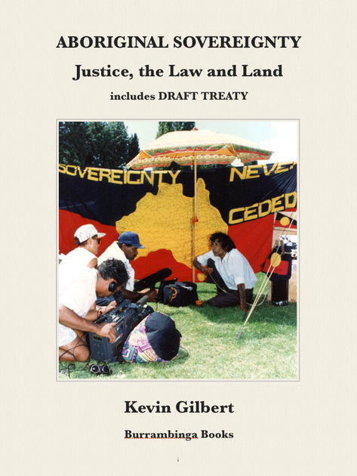

Slide 6
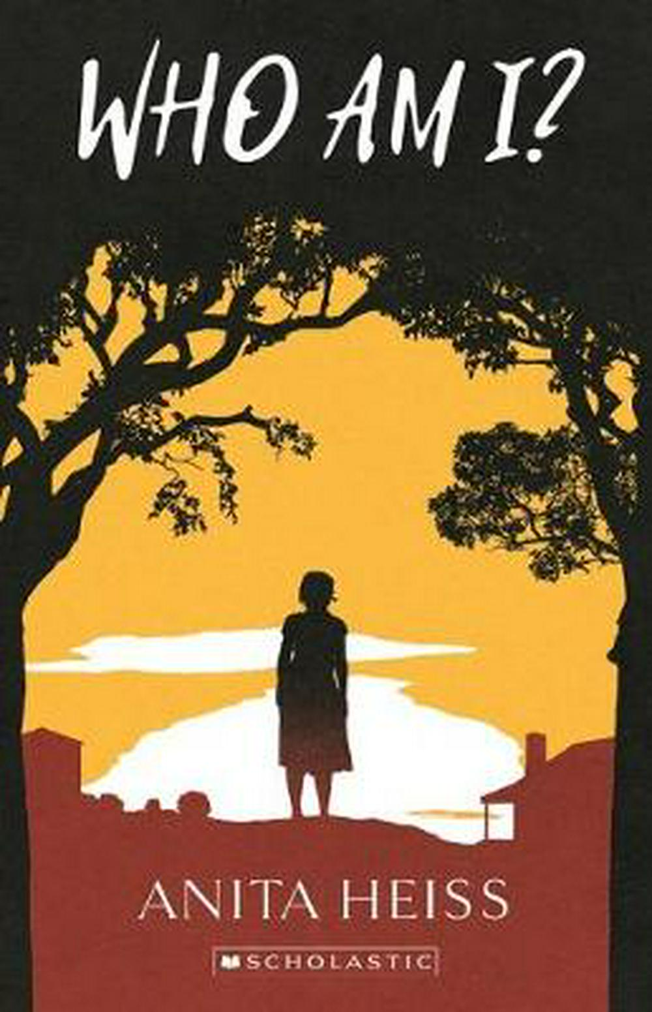

Slide 7
Easy ways to share language in your school and workplace
Greetings
Signage
Room names
House Names – local animals
Values in the classroom in local language
This Painting by Ron Wardrop is on the principal’s door at Parkes East Public School, where Ron used to teach a Wiradjuri language class. Balgabalgar is a Wiradjuri word meaning boss, king or person in charge. Photo: AIATSIS

Slide 9
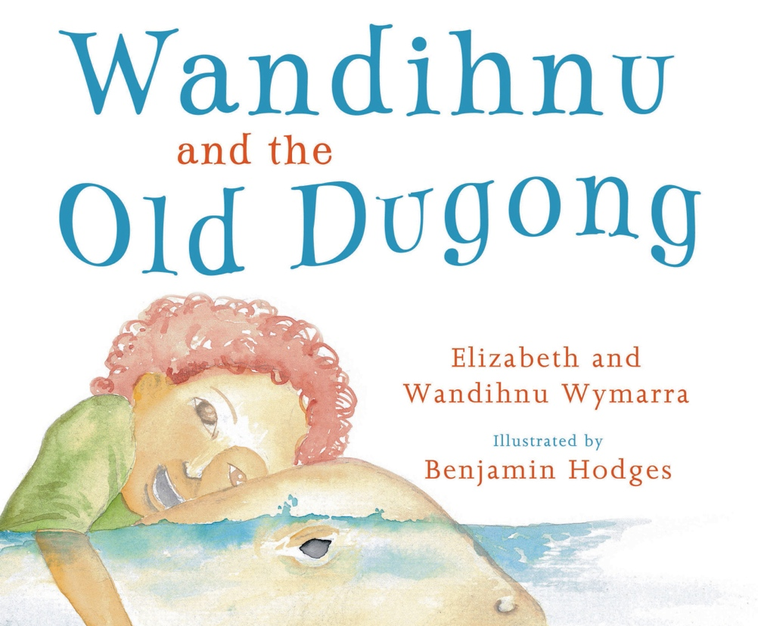
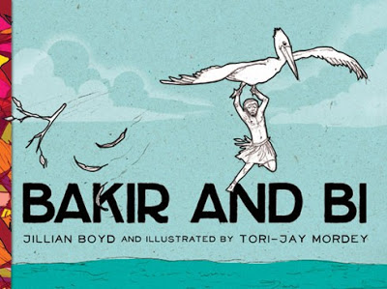
www.magabala.com
Magabala Books is Australia's leading Indigenous publisher. Based in the pearling town of Broome in the far north of Western Australia, Magabala Books is one of the most remote publishing houses in the world.
Since its incorporation in 1990, Magabala Books has been recognised as a producer of quality Indigenous Australian literature receiving accolades in prestigious literary and national achievement awards.
As one of the most respected small publishing houses in Australia, Magabala Books works to celebrate the talent and diversity of Aboriginal and Torres Strait Islander voices through the publication of quality literature. Magabala Books has released more than two hundred titles from a range of genres.

Slide 10
www.magabala.com
It’s hard to soar like an eagle when you’re surrounded by turkeys!

Slide 11
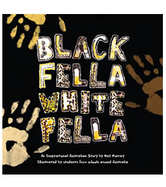
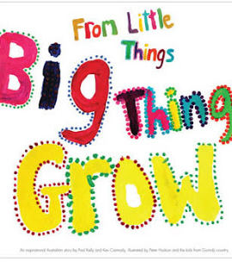
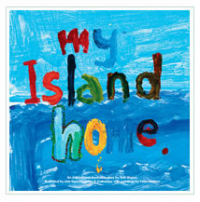
Children’s picture books
One Day Hill Publishers
Song books
History books
Interviews with Archie Roach
Bilingual books

Slide 12
www.onedayhill.com.au

Slide 13
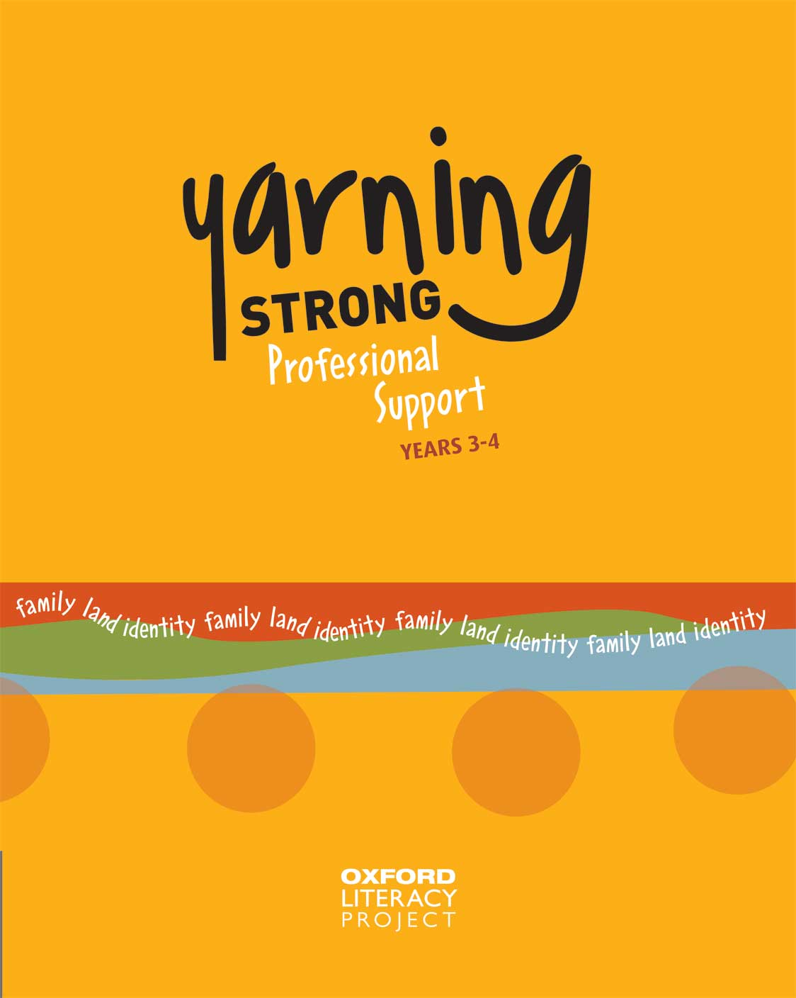
www.oup.com.au
Family
Identity
Land

Slide 14
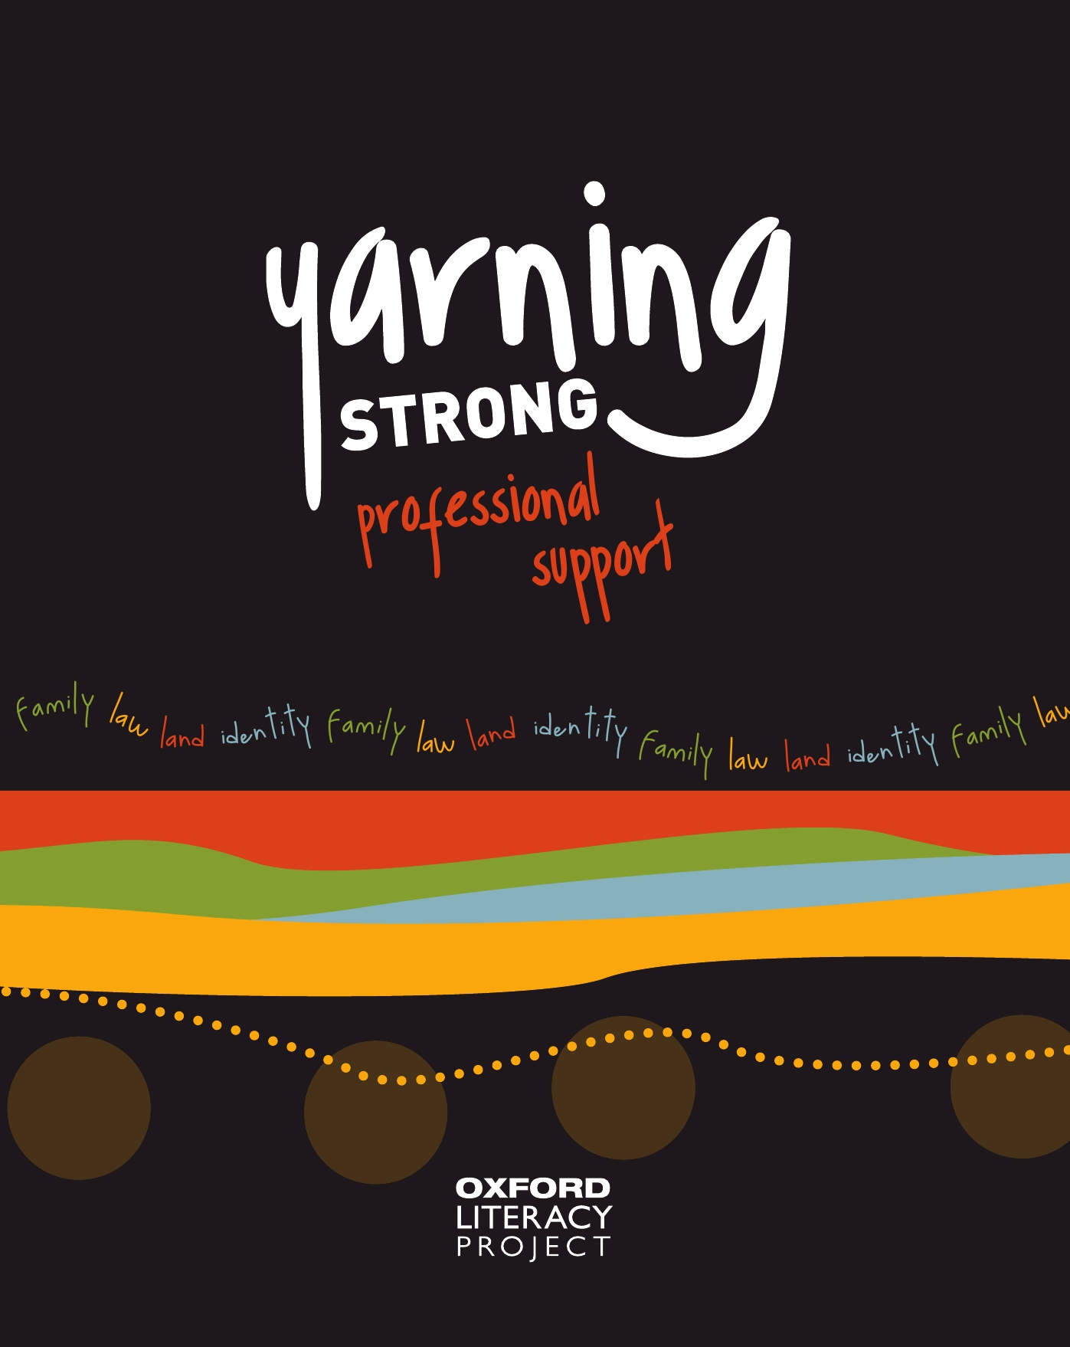
What’s it like being an Indigenous kid in urban Australia?
The series offers teachers a resource that will:
stimulate classroom discussion
assist in dispelling stereotypical, and often negative, racial assumptions.
promote understanding and celebrate differences.
Four themes: Land, Family, Identity, Law
Target audience: upper primary and lower secondary

Slide 15
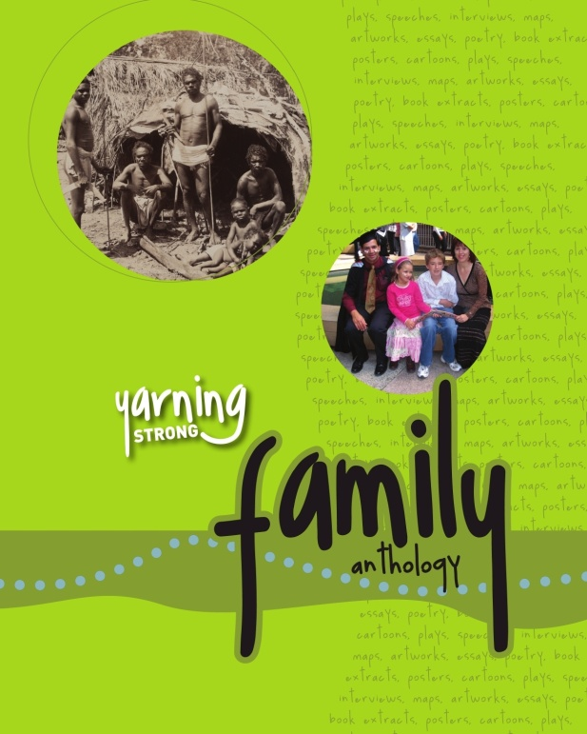
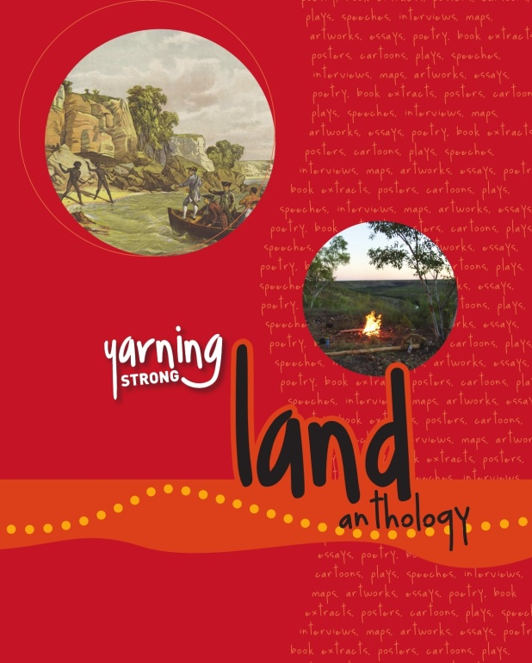
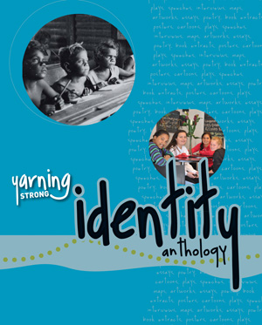
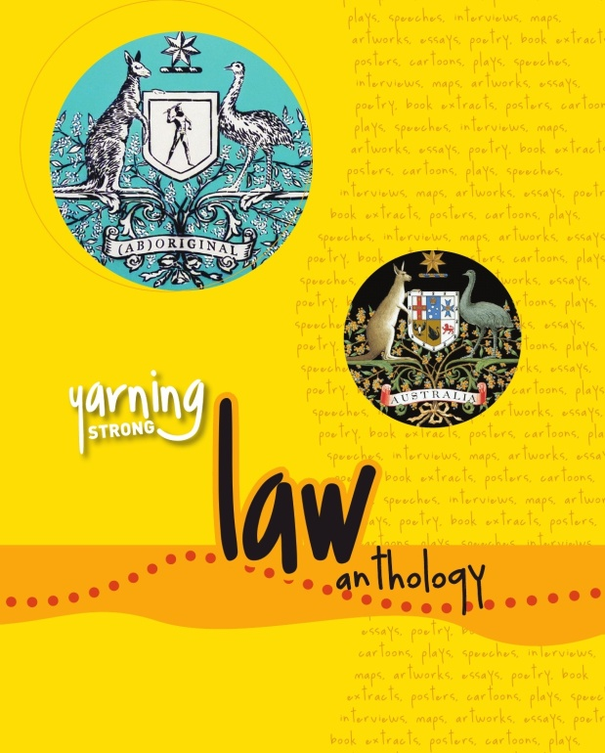

Slide 16
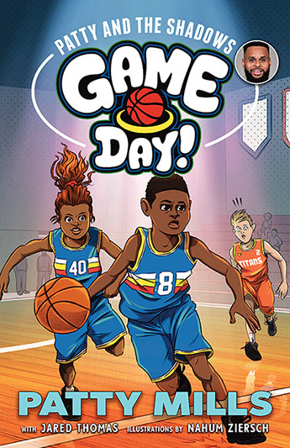
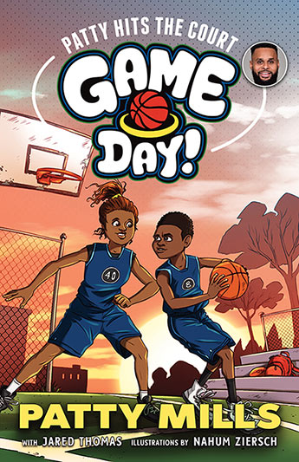
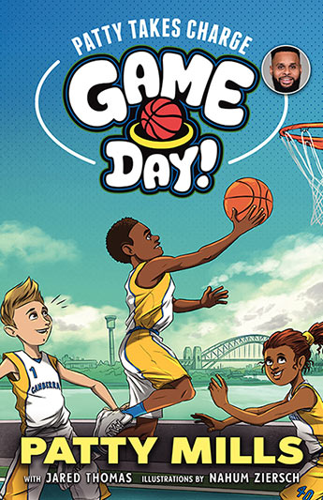
Patty (Patrick) Mills and Jared Thomas
A fantastic and fun basketball series by Australian Olympian and NBA star Patty Mills that will entertain young readers, inspire kids to achieve their goals through sport, and showcase Patty's pride in his Indigenous heritage.
Age: 6-9
Allen & Unwin

Slide 17
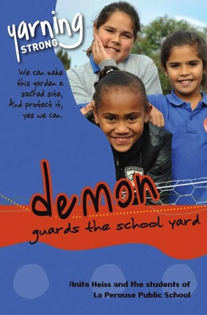
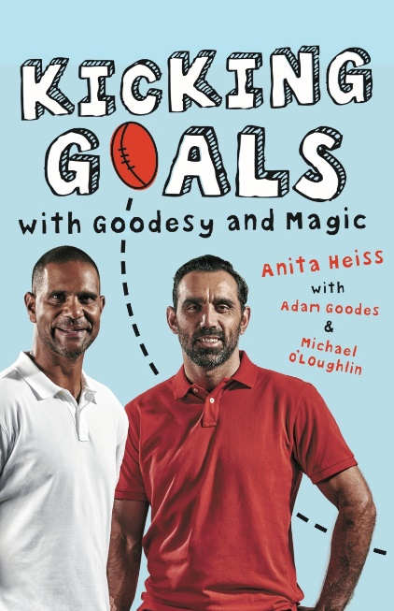

Slide 18
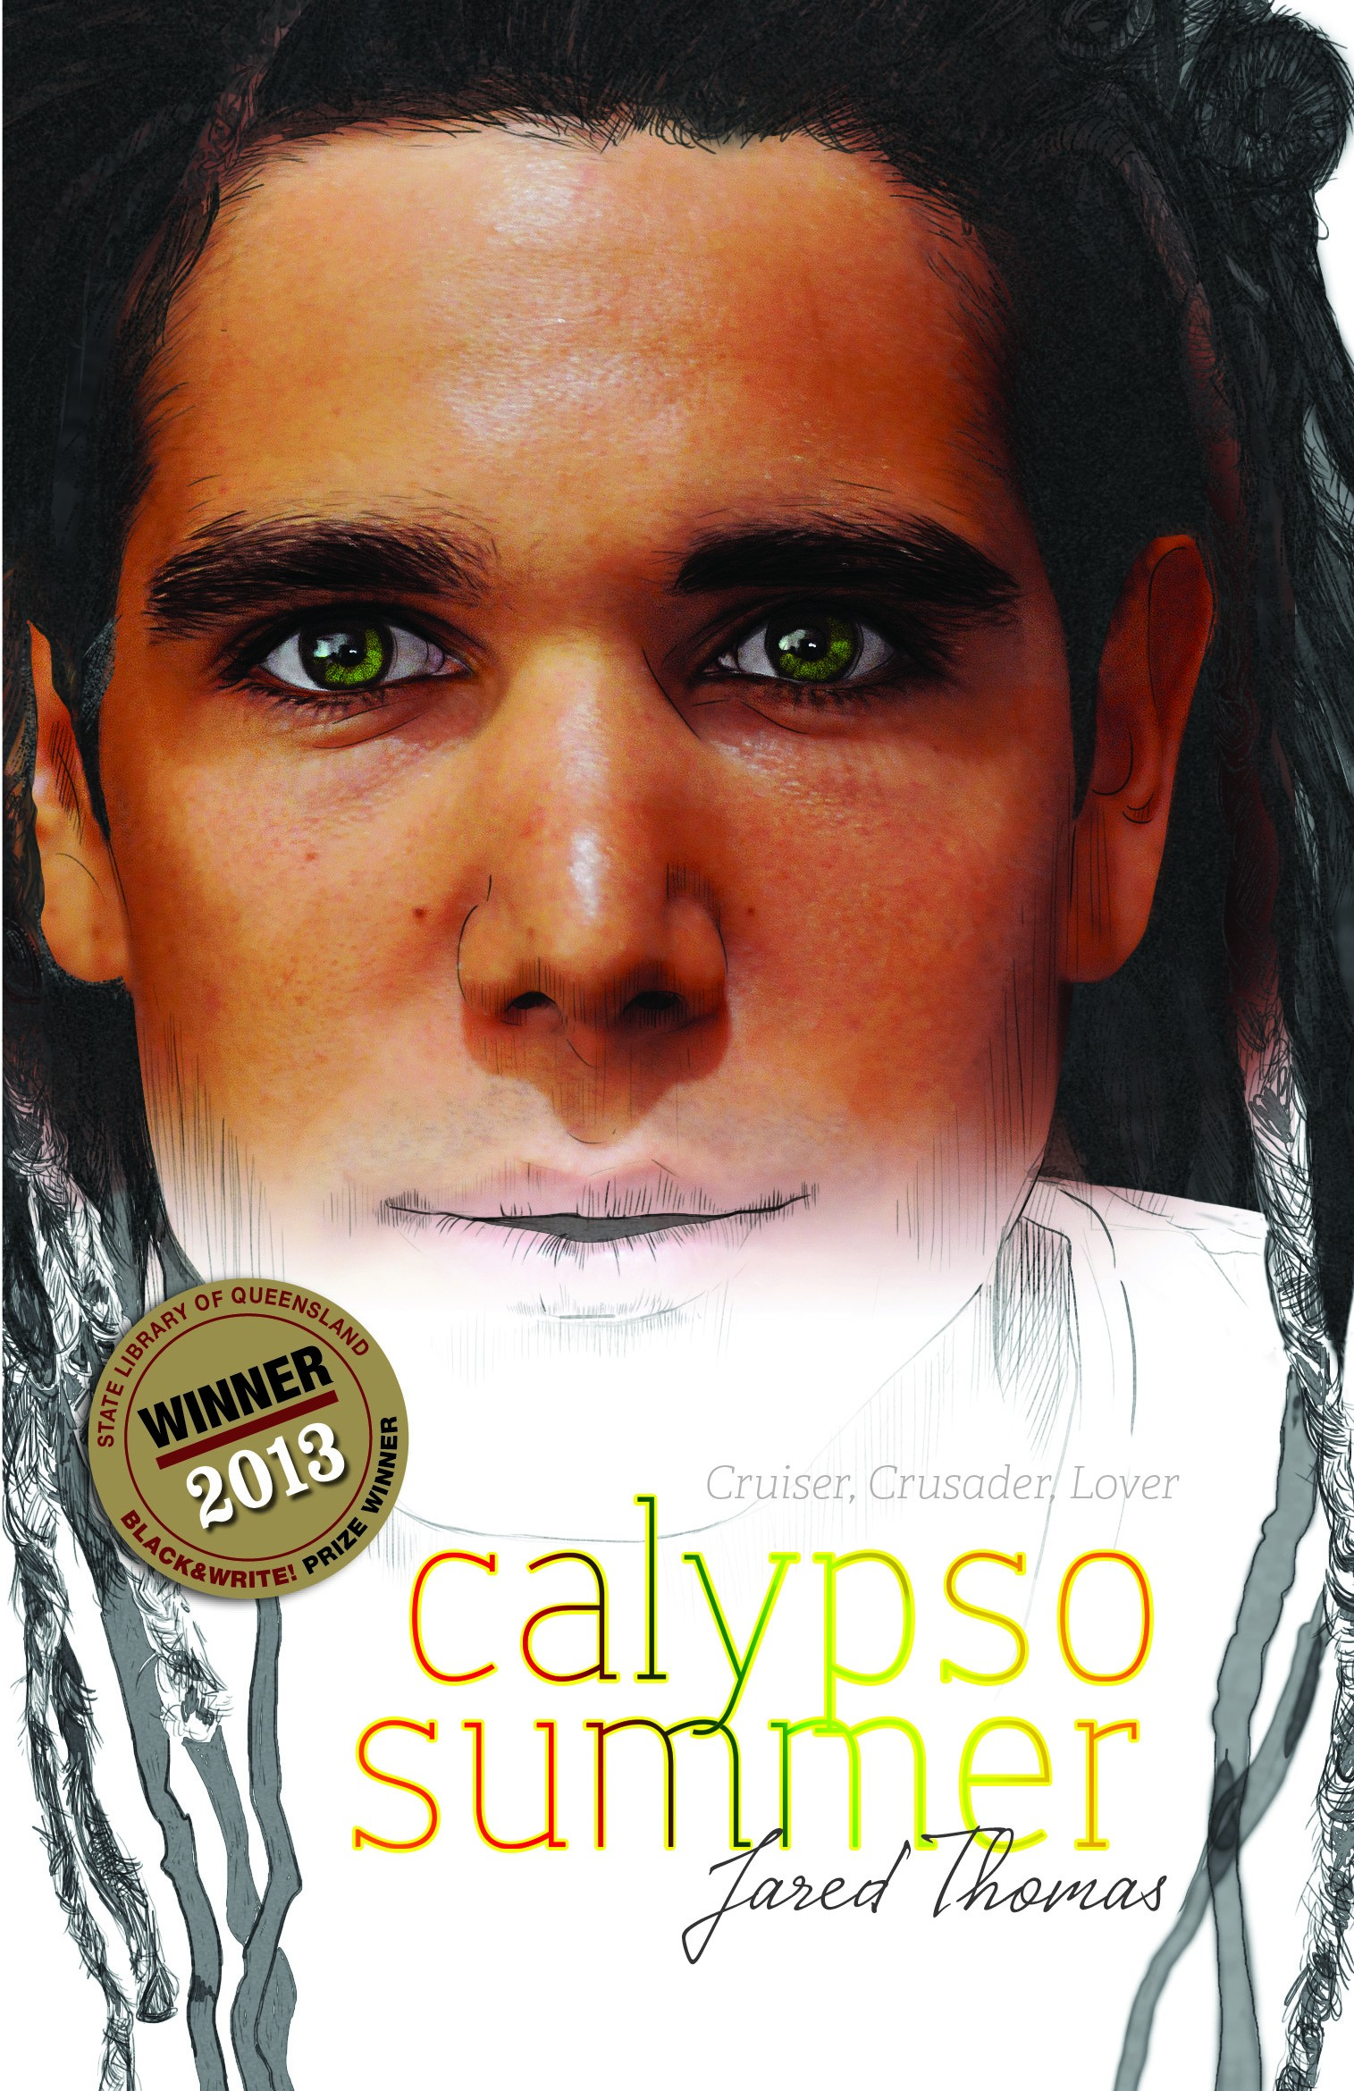
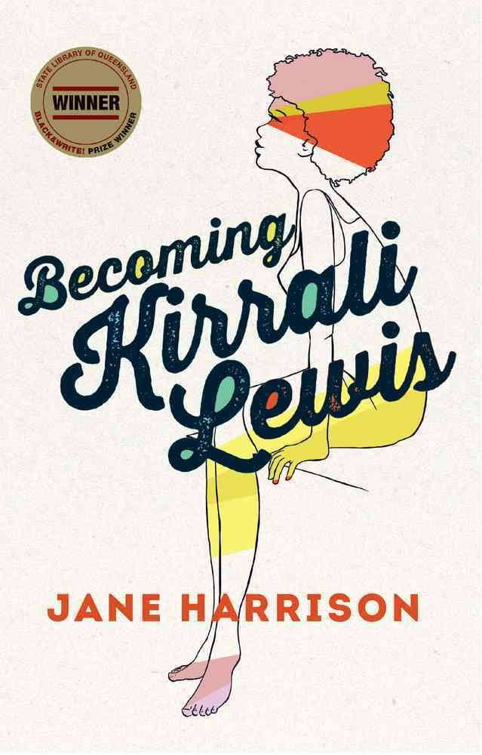
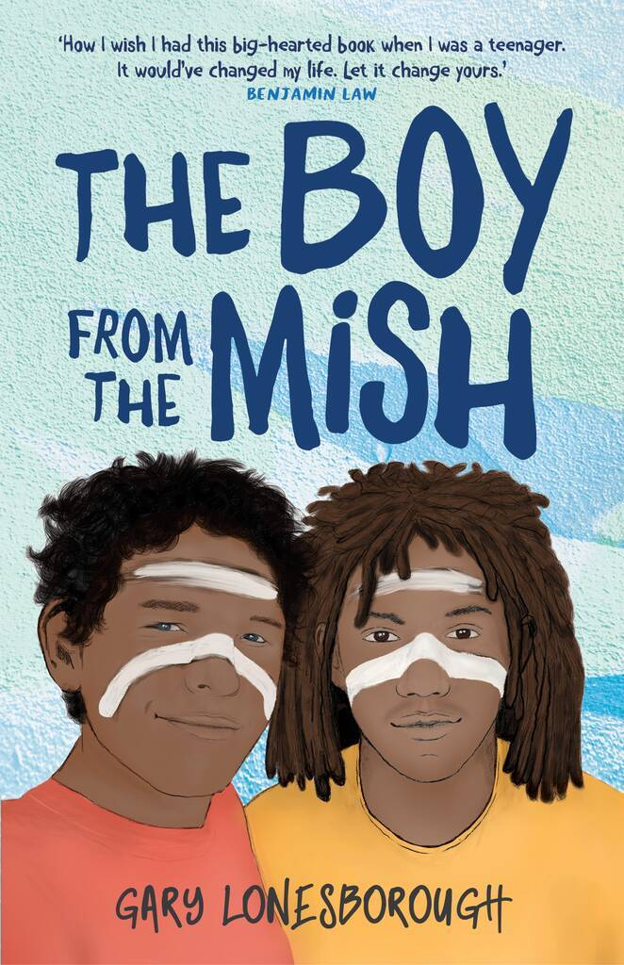
Years 9-12

Slide 19
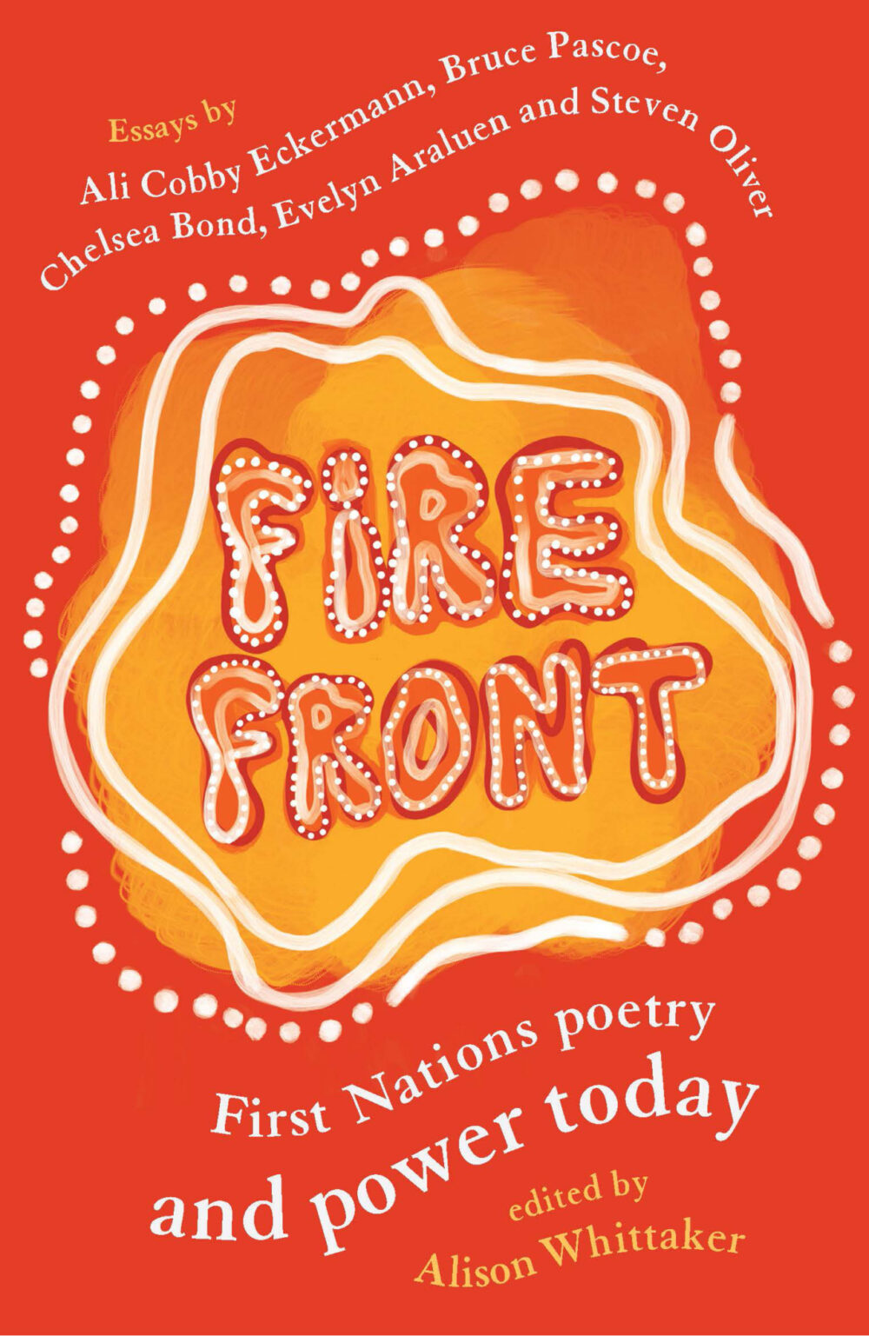
Themes:
• Aboriginal and Torres Strait Islander customs and beliefs: - Kinship - Community - Stories - Spirituality
• Racism in Australia
• Impacts of colonisation on Aboriginal and Torres Strait Islanders
• Stolen Generation
• Black deaths in custody, youth detention
• Surviving colonisation
• History wars (divided opinion about how to represent Australian history)
• Identity and belonging: Aboriginal and Torres Strait Islander, ‘Australian’ and Settler identities

Slide 20
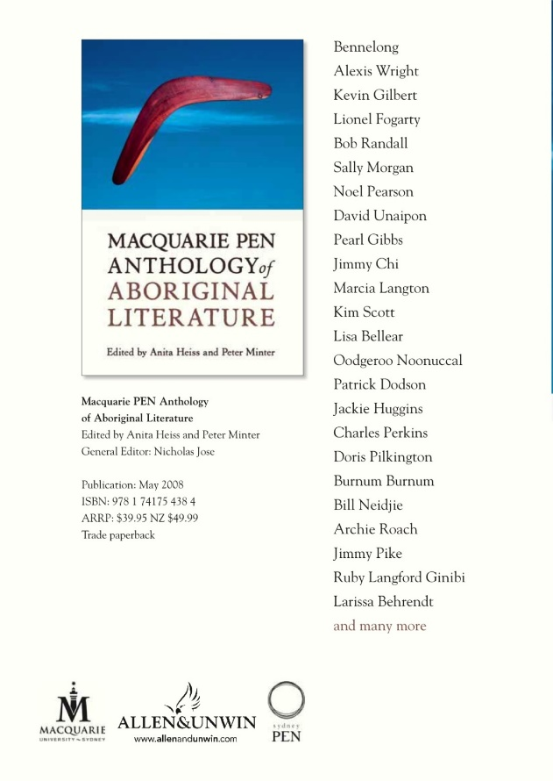
Notes:
Macquarie PEN

Slide 22
Recent memoirs: stories of resilience

Slide 23
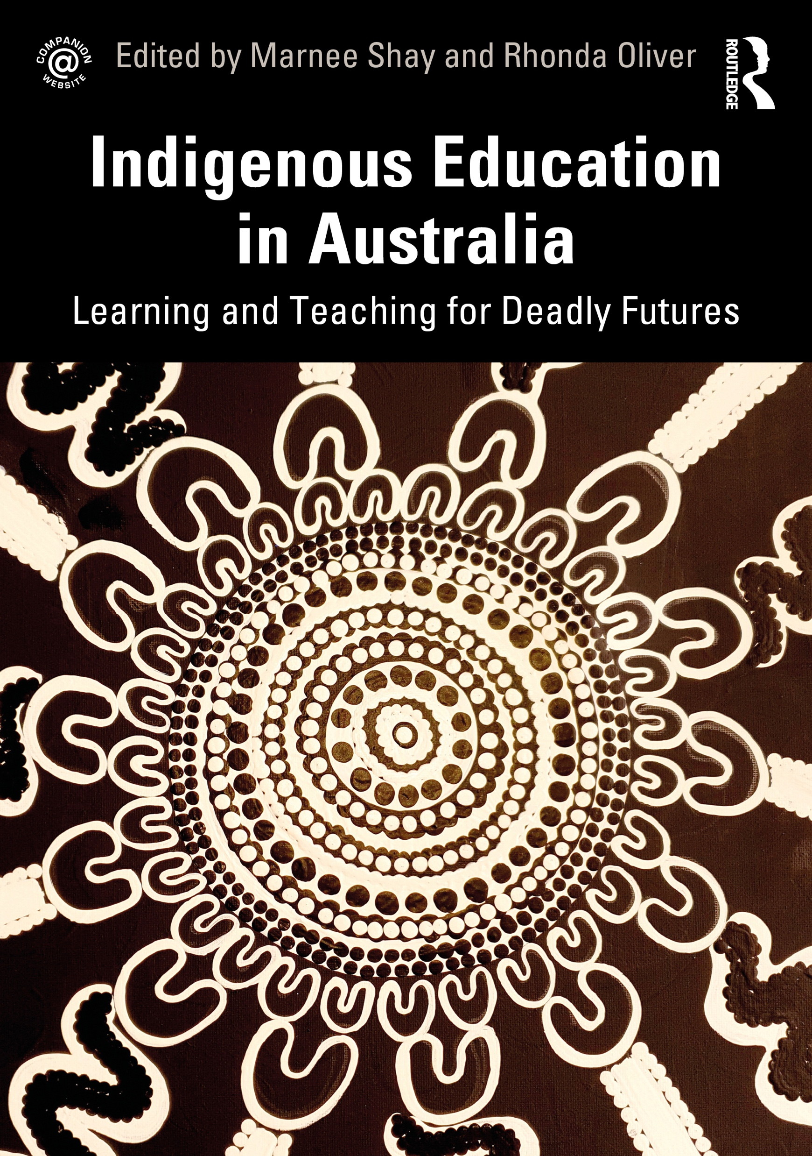
Our intent in this book is for pre-service and in-service teachers to understand that:
• All Indigenous people – students, their families, Elders and communities have strengths, abilities and capacities
• Indigenous people are experts in their lives
• The problem is the problem; the person is not the problem
• People and situations can change
• Indigenous students and their families are doing the best they can
• There is a power in stories that bring about possibilities for change and reimagining what is possible

Slide 24
www.austlit.edu.au/

Slide 25
Alice Eather
Yura Karraburra (fire is burning)

