Slide 1

ONTARIO:
KEYS TO MAXIMIZING LEARNING FOR ALL STUDENTS
Joanne Robinson
Notes:
A bit about myself – from the Ontario Principals Council – a voluntary professional association which has only been in existence since 1998. We support members (P/VP, SO and emerging leaders) through professional learning and consultation when in difficult situations.

Slide 2

Snapshot – Province of Ontario
Ontario has:
40% of Canada’s 33.6 million people (it is the most populous province)
In 2016, Ontario received 37.3% of permanent resident admissions to Canada (320,932 new immigrants landed in the country as permanent residents)
Over 1 million square kilometres of land
2.1+ million students
English is not the first language of many of our students
Almost 126,000 teachers (unionized teaching and support staff)
About 5,000 schools in 72 school districts
Notes:
The most important message here is that my experience tells me that there is more in common between Canada and Australia than different.
So I imagine that you signed up for this presentation to either confirm that you are on the right track and that innovative ideas that you are working on are working in other jurisdictions – or you are looking for some new and fresh ideas because you have reached an impasse in your system and are looking for some inspiration

Slide 3

Elementary Outcomes: Achievement Results
Over 170,000 more students at provincial standard
Overall Elementary Achievement Growth:
2002-03 to 2015-16
4 key levers for elementary reform:
Improving classroom teaching and learning
Improving school effectiveness
Leadership
capacity building
Research and evaluation
Provincial Results Not Available
Notes:
Intro to this Chart
To reference one of the top performing educational systems in the world now widely publicized in books from Michael Fullan, Andy Hargreaves, Lyn Sharratt, Andy Hargreaves, for achieving sustained achievement results… you will see from Ontario’s journey of lessons learned that there were four key levers found to be crucial in educational reform and improving on the quality of teaching and learning opportunities for all students and all schools.
From this chart, you will see…
The overall combined Grade 3 and 6 EQAO results for 2013-14, both English and French boards, is 72%. This is an increase of one percentage point compared to 2012-13, and 18 percentage points compared to 2002-03.
This increase represents more than 170,000 elementary students now have higher proficiency in reading, writing, and mathematics.
EQAO assessment results show progress is being made, but there is still more work to be done to help students who are working toward meeting the provincial standard. We are pleased that the 2013-14 overall results show a continuing upward trend, but very frustrated that one area, mathematics, is persistently trending the wrong way.
Progress over the past ten years is a result of focused work centred around 4 key levers for elementary improvement:
Improving classroom teaching and learning
Improving school effectiveness
Leadership capacity building
Research and Evaluation

Slide 4
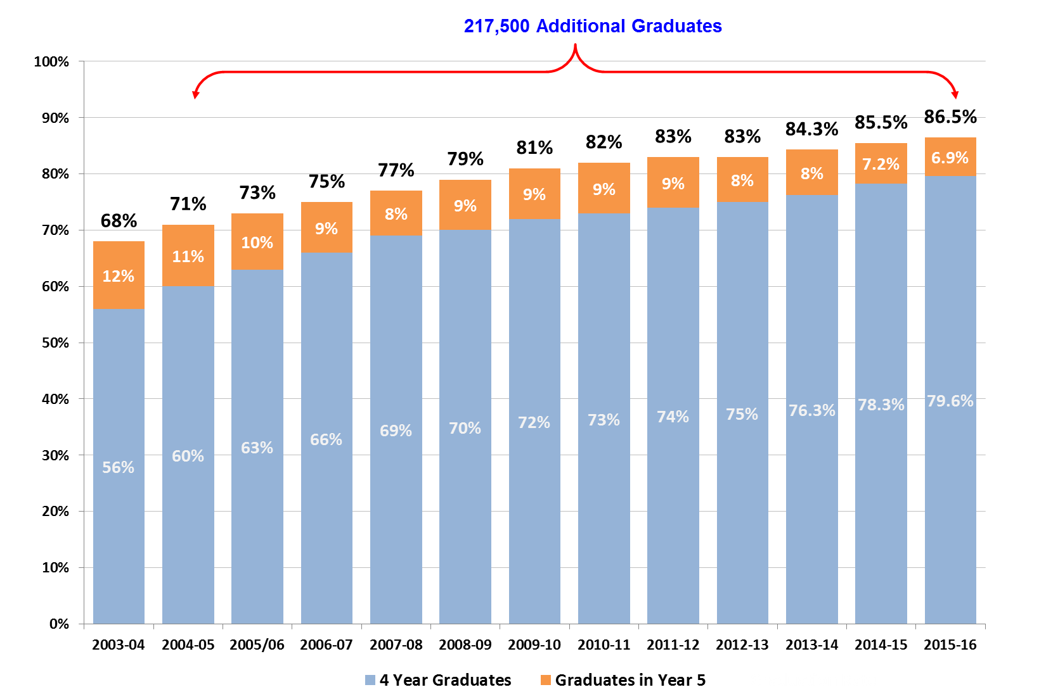
High standards and expectations: Provincial Graduation Rate
6 key levers for secondary reform:
Leadership infrastructure
Engaging and relevant programming
Effective instruction
Focused Interventions for students at risk of not graduating
Legislation and policy development
Research, monitoring and evaluation
Notes:
The rate is now at 86.5%. In 2015-16 there were approximately 127,000 graduates from the cohort of students who started grade 9 in 2011-2012. This number also includes those students who graduated within four years.
Our target is 85% of Ontario students will graduate in 5 years which is up from the 68% graduation rate in 2003-04 when the government took office.
In 2015-16 alone, approximately 27,500 additional students graduated than would have had the rate remained at the 2003-04 rate of 68%. This is a total of approximately 217,500 more students who have graduated since 2003-04 than would have if the Student Achievement Strategy were not in place.
The province continues to publish each board’s grad rate. This will continue to draw attention to our efforts to help more students be successful.
This significant success allows us to think now more deeply about what successfully completing secondary school should give our students…
An Ontario Secondary School Diploma,
An entry qualification for post-secondary learning, the workplace, or apprenticeship
Preparation for a successful life
A means by which to clarify their interests, goals, assets / strengths, and ability to learn
A means to develop good character and judgement
and innovating, creative and “entrepreneurial” orientation (in full, not just business) (ie. a predisposition to action)
And let’s not forget that there are students for whom preparation for independent living is a pursuit of equal value in our system.

Slide 5







Ontario Benefits from Key Advisors
International School Leadership, a subsidiary of the Ontario Principals` Council provides training and certification program to K-12 school and system leaders around the world, professional consulting services and program customization.
But our real expertise comes from our members.
Notes:
In Ontario we are blessed to have so many internationally recognized leaders and researcher who help us maintain the momentum and focus on continuous improvement. While

Slide 6

LEADERSHIP
Leadership is the exercise of influence on organizational members and diverse stake-
holders toward the identification
and achievement of the organization’s vision and goals.
(Ontario Leadership Framework, 2013)
.
Notes:
Hopefully you will recognize that leaders are everywhere in your organization. Some have a title that identifies them as a leader, while many are people you work with who influence others and are role models – and the challenge is to ensure that their influence supports the goals that are valued by the system. We need to put the fun back into learning and leading and share our joy of watching students grow and learn and appreciate the excitement in the times in which we are living. It is not easy with all of the pressures we are now sensing, but with the sense of shared learning the pressure dissipates.

Slide 7

LEVERS TO SUCCESSFUL
IMPROVEMENT SYSTEMS
A small number of ambitious goals
A guiding coalition at the top
High standards and expectations
Investment in leadership and capacity building related to instruction
Mobilizing data and effective practices
as a strategy for improvement
Intervention in a non-punitive manner
Reducing distractions
Being transparent, relentless
and increasingly challenging
Notes:
Here are the key levers we use to leverage success across our system. I’ll elaborate a bit on each of these….

Slide 8

Ontario’s
Goals
for
Education
Achieving Excellence: Children and students of all ages will achieve high levels of academic performance, acquire valuable skills and demonstrate good citizenship. Educators will be supported in learning continuously and will be recognized as among the best in the world.
Ensuring Equity: All children and students will be inspired to reach their full potential, with access to rich learning experiences that begin at birth and continue into adulthood.
Promoting Well-Being: All children and students will develop enhanced mental and physical health, a positive sense of self and belonging, and the skills to make positive choices.
Enhancing Public Confidence: Ontarians will continue to have confidence in a publicly funded education system that helps develop new generations of confident, capable and caring citizens.

Slide 9

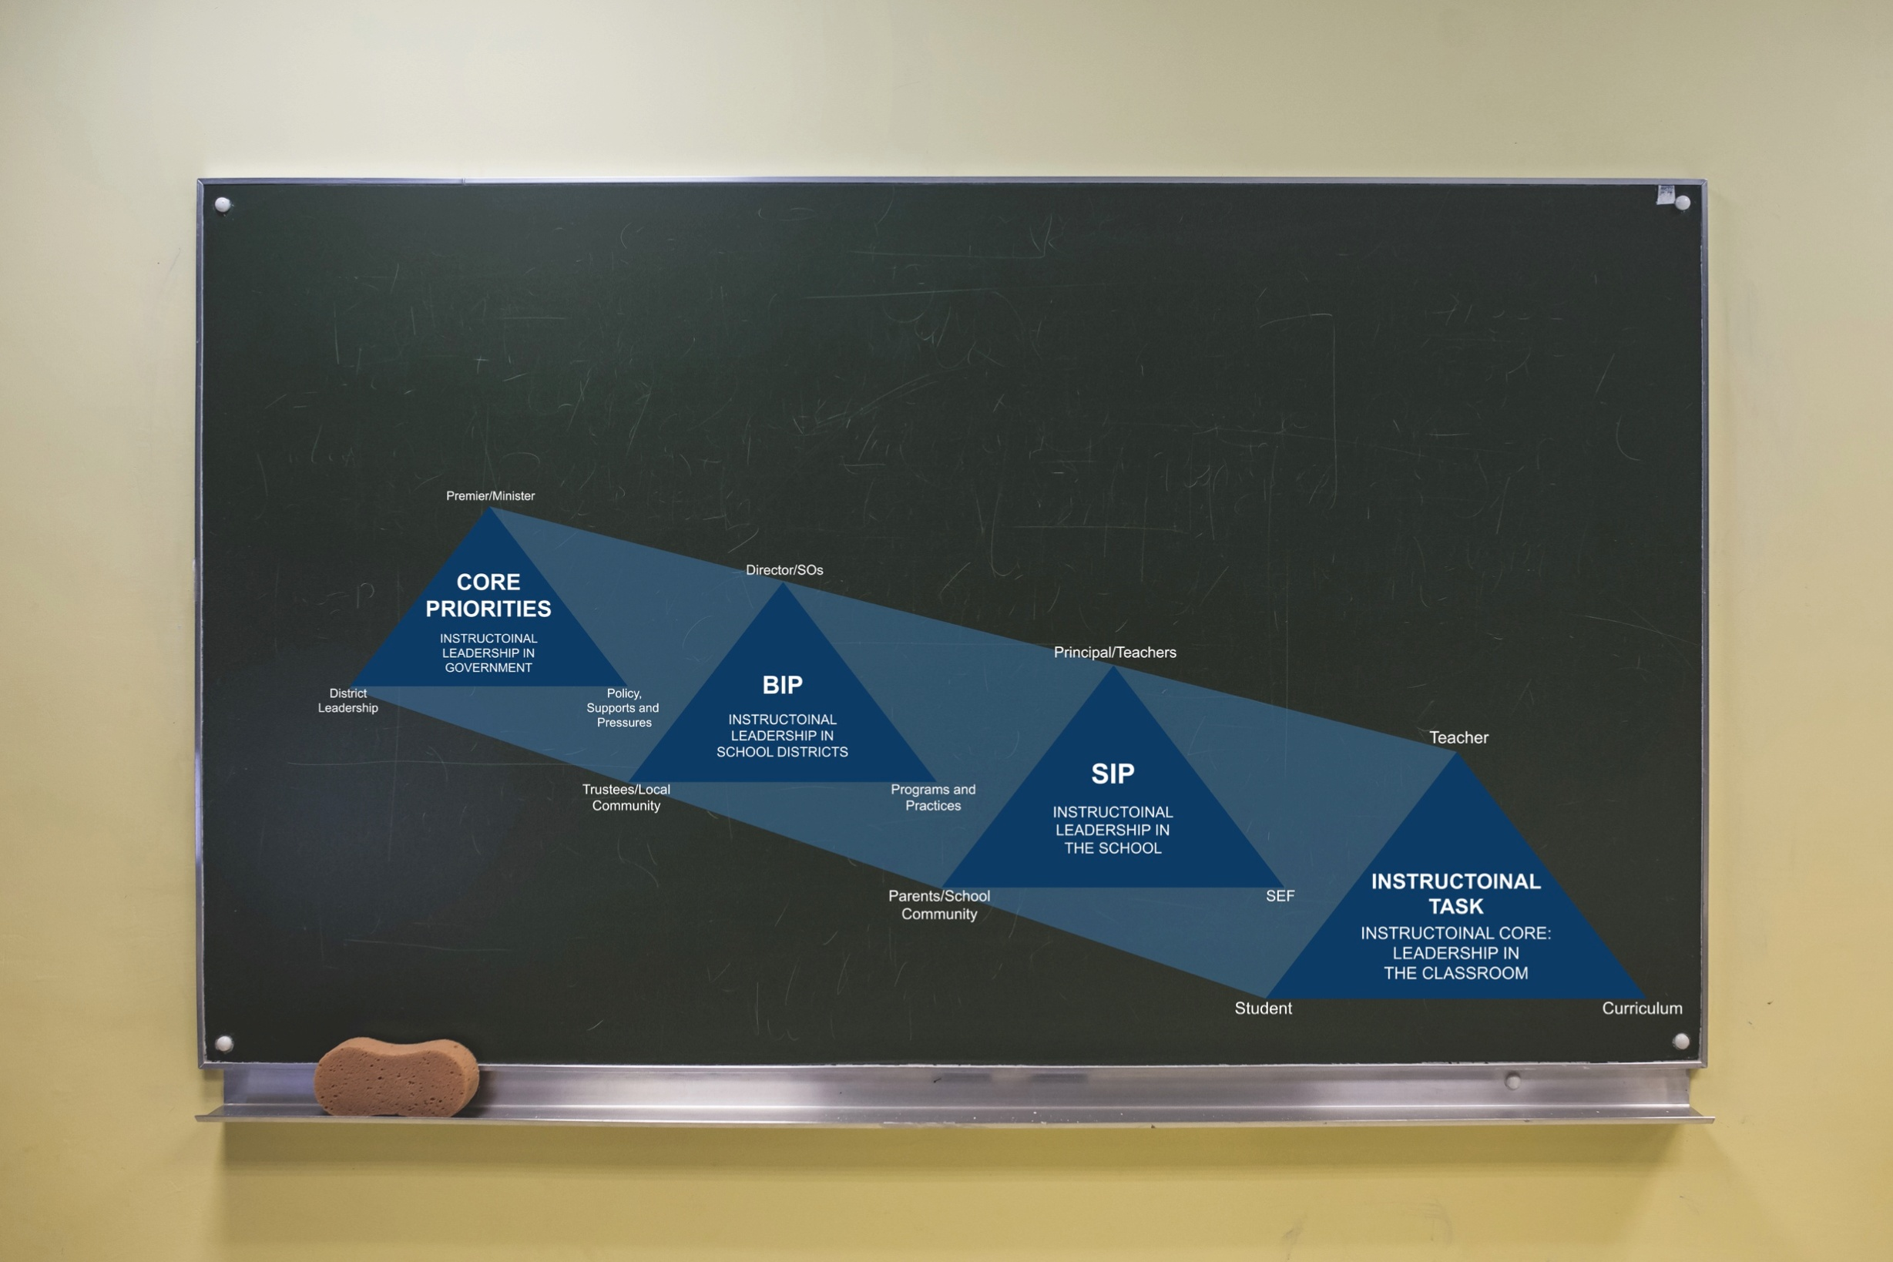
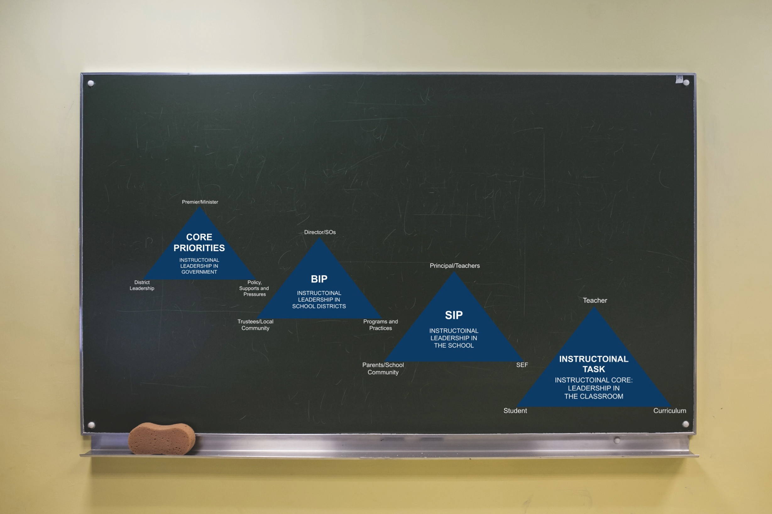
Leadership and capacity building related to instruction –
Focus, alignment and coherence
Notes:
One simple message – the more aligned and coherent the work at each level – the more progress will be made.
Equilateral triangle

Slide 10

The Power of Frameworks
School Level Leadership
School Effectiveness Framework
System Level Leadership
District Effectiveness Framework
Qualification Programs
Notes:
Common language
Catalyst for powerful conversations and reflections
Challenging conversations become focused on the students
Conversations about activities or strategies – impersonal

Slide 11
#1 Academic Emphasis = .52 (#5 Texas)
#2 Teacher trust in others = .45 (#1 Texas)
#3 Collaborative Structures/ Cultures = .36 (#7 Texas)
#4 Collective teacher efficacy = .35 (#2 Texas)
#5 Classroom instruction = .33 (#10 Texas)
The “big five” Power Indices using strong district research from
Ken Leithwood’s Powerpoint from ISL meeting June 27
Notes:
Hopefully you will recognize that leaders are everywhere in your organization. Some have a title that identifies them as a leader, while many are people you work with who influence others and are role models – and the challenge is to ensure that their influence supports the goals that are valued by the system.

Slide 12
EXTRAORDINARY
LEADERSHIP FOR
EXTRAORDINARY
TIMES
“Leadership is second only to classroom instruction among all school-related factors that contribute to what students learn at school.”
(The Wallace Foundation – Learning from Leadership Project)
“...because principals can have
an impact on student achievement, improving the quality of school leadership is more important than improving the quality of a single teacher’s practice.”
(Andreas Schleicher, Schools for 21st-Century Learners, 2015)
Notes:
FIRST... What is the potential of school leadership for deepening impact?
What do we mean by ‘leadership’?
When we talk about leadership, we mean ‘leadership as the ability to influence others to attain a common goal.’ In education, the common goal has to be student learning.
What is the impact of school leadership?
If we consider the impact of school leadership as second only to classroom instruction, we already have confirmation from research data that “leadership is second only to classroom instruction among all school-related factors that contribute to what students learn at school.” (The Wallace Foundation – Learning from Leadership Project)
AND this second important nugget from the recent OECD Backgrounder – from the 2015 International Summit on the Teaching Profession goes even further to clarify how we can get the most ‘bang for our buck’ for enabling school and system leadership that supports teachers:
“...because principals can have an impact on student achievement, improving the quality of school leadership is more important than improving the quality of a single teacher’s practice.” (Andreas Schleicher, Schools for 21st-Century Learners, 2015)

Slide 13
THE TIME FOR
LEADERSHIP
IS NOW
“The greatest influence on student progression in learning is having highly expert, inspired and passionate teachers and school leaders working together to maximize the effect of their teaching on all students in their care.”
John Hattie
What Works Best in Education:
The Politics of Collaborative Expertise (2015)
Notes:
IN SUMMARY
We all know that initiative overload and fragmentation pull us and our best plans from deepening our impact. The good news is that we have increasing acknowledgement of the potential of leadership AND increasing precision about dimensions about the knowledge and expertise to deliver.
“The solution requires the individual and collective ability to build shared meaning, capacity, and commitment to action. When large numbers of people have a deeply understood sense of what needs to be done---and see their part in achieving that purpose---coherence emerges and powerful things happen.”
Source: Coherence by Michael Fullan and Joanne Quinn
IN CONCLUSION
Our students need you, and indeed, the world needs you as educators and leaders to survive and thrive. In conclusion, it’s never been a better time for school leadership. The time is now.
Thank you.

Slide 14
COHERENCE
MAKING
Alignment is about structures; coherence
is about mindsets.
System coherence is about shared mindsets.
A tool is only as good as the
mindset using it.

Slide 15

ELEMENTS OF
COHERENCE
A small number of ambitious goals
A focus on instruction and the student achievement agenda
Continuous capacity building
around that agenda
Cultivation of ‘systemness’
on the part of all
Notes:
Everyone in the system needs to see themselves in the success of every student.

Slide 16

Focusing Direction
Purpose Driven
Goals That Impact
Clarity of Strategy
Change Leadership
Cultivating
Collaborative
Cultures
LEADERSHIP
Securing
Accountability
Deepening
Learning
FOCUSING
DIRECTION
Notes:
COHERENCE: THE RIGHT DRIVERS IN ACTION FOR SCHOOLS, DISTRICTS, AND SYSTEMS
Focusing Direction:
Purpose Driven
Goals That Impact
Clarity of Strategy
Change Leadership
Clarity in focusing direction can mean two or three ambitious goals that are needed to attain a specific vision. This means reframing so that everyone sees the connections, it means identifying time wasters and inefficiencies. Coherence here is about strategy defined as a “shift in shared mind-set rather than alignment,” which is about getting structures right.

Slide 17

Cultivating Collaborative
Cultures
Culture of Growth
Learning Leadership
Capacity Building
Collaborative Work
Focusing
Direction
LEADERSHIP
Securing
Accountability
Deepening
Learning
CULTIVATING COLLABORATIVE
CULTURES
Notes:
Creating collaborative cultures is about:
developing a culture of growth: mind-sets matter; this is not about compliance,
the principal as ‘lead learner’,
Creating learning situations that promote inquiry habits of mind throughout the school,
Modelling lead learning.

Slide 18

Focusing
Direction
Cultivating
Collaborative
Cultures
LEADERSHIP
Deepening Learning
Clarity of Learning Goals
Precision in Pedagogy
Shift Practices
Through Capacity
Building
Securing
Accountability
DEEPENING
LEARNING
Notes:
Deepening Learning:
Clarity of Learning Goals
Precision in Pedagogy
Shift Practices Through Capacity Building

Slide 19

Focusing
Direction
Cultivating
Collaborative
Cultures
LEADERSHIP
Securing
Accountability
Internal Accountability
External Accountability
Deepening
Learning
SECURING
ACCOUNTABILITY
Notes:
Securing Accountability:
International Accountability
External Accountability
At the core of accountability in educational systems is student learning. Constantly improving and refining instructional practice so that students can engage in deep learning tasks is perhaps the single most important responsibility of educational systems as a whole. In this sense, accountability is not limited to gains in test scores but on a more meaningful level for all students.
Hargreaves & Shirley, 2009: “Internal accountability occurs when individuals and groups willingly take on personal, professional and collective responsibility for continuous improvement and success for all students.”

Slide 20

SEVEN LEADERSHIP
COMPETENCIES
Challenges the Status Quo
Builds Trust Through Clear Communication
and Expectations
Creates a Commonly Owned Plan for Success
Focuses on Team over Self
Has a High Sense of Urgency for Change and Sustainable Results in Improving Student Achievement
Has a Commitment to Continuous
Improvement for Self and Organization
Builds External Networks and
Partnerships
Notes:
Leadership is the field of study where there is no shortage of research, theory and literature on effective practice. Leadership in education probably leads the field in research about leadership. Our own Michael Fullan, who we work with regularly, is a prolific writer and internationally known speaker. He often teams up with other experts in the field and produces succinct ideas that every educator can relate to. His most recent book written with Lyle Kitterman outlines and describes the 7 competencies that lead to whole system change.
In my workshop this afternoon I will be giving the participants an opportunity to explore each of these in a more practical/application mode but you can see that this research aligns very closely to all other qualities of leadership that lead to improved student learning. The lists are great and serve as a reminder that it is ok to change things up and think outside the box – but the reality is that it is how we enact these competencies that really creates the climate in our schools.

Slide 21

Ontario Leadership Framework Domains
Setting Goals
Building Relationships and Developing Others
Developing the Organization to Support Desired Outcomes
Improving the Instructional Program
Securing Accountability
ONTARIO
LEADERSHIP
FRAMWORK
(OLF)

Slide 22

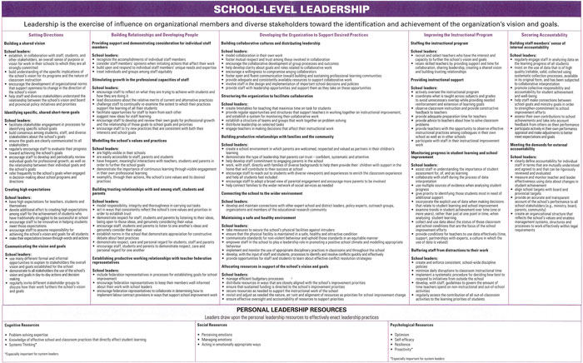
Notes:
Placemat activity; identify areas that emphasize teachers as leaders and leaders working with teachers.
Hand-out of the OLF in Spanish.
ACTIVITY PROMPT: TURN AND TALK (to someone you do not know/you have not dialogued with yet)
---Read through and find evidence of effective leadership practices.

Slide 23
PERSONAL
LEADERSHIP
RESOURCES
Cognitive
Problem-solving expertise
Knowledge of effective school and classroom practices that directly affect student learning
Systems Thinking
Social
Perceiving emotions
Managing emotions
Acting in emotionally appropriate ways
Psychological
Optimism
Self-efficacy
Resilience
Proactivity

Slide 24

IDEALLY…
When teachers and principals work together, great things happen for kids.
Notes:
What we want to explore today is the notion of looking at how much deeper the impact can be when we’re all leaders and we’re all working together.
In Ontario we have gone from a system that pursues many initiatives at a superficial level – to one that brings clarity to what it is we’re focusing upon – from a mile wide, inch deep to inch wide and mile deep.

Slide 25
EXTRAORDINARY
LEADERSHIP
Grit: your capacity to dig deep and do whatever it takes – even sacrifice, struggle and suffer – to achieve your most worthy goals in the best way
LEADERSHIP GRIT: your capacity to get your team, or followers in general, to dig deep and do whatever it takes – even sacrifice, struggle and suffer – to achieve their most worthy goals in the best ways

Slide 26

DIMENSIONS
OF GRIT
Your propensity to seek and consider new ideas, additional alternatives, different approaches, and fresh perspectives.
Every leader would agree with the importance of thinking differently,
the challenge is doing so ‘in
the heat of battle’.
Leader to Leader Fall 2015
Paul G Stolz p. 50
^{Growth}

Slide 27
DIMENSIONS
OF GRIT
Your capacity to respond constructively to – and ideally make good use of
– all kinds of adversity.
This means you harness adversity
– using it to propel you to a
place you never would
have arrived at without
the adversity.
Leader to Leader Fall
2015 Paul G Stolz
p. 51
^{Resilience}

Slide 28
Your gut-level
capacityto pursue the
right goals in the right ways.
Instinct, when used in this
sense,is pivotal to good leadership.
Wasting time and energy by pursuing
less than optimal goals in less than optimal ways can be counter-productive to moving forward.
Leader to Leader Fall 2015 Paul G Stolz p. 51
^{Instinct}
DIMENSIONS
OF GRIT

Slide 29
DIMENSIONS
OF GRIT
The degree to which you persist, commit to,
stick with, and relentlessly work at whatever
you choose. Without it, when it comes to
long-term, difficult goals, nothing
much happens.
The more robust you are as a
leader, the better you hold up, and
ideally the stronger and better
you become. The same is
true for the people on
your team(s).
Leader to Leader Fall 2015
Paul G Stolz p. 52
^{Tenacity}
^{and}
^{Robustness}

Slide 30
Ministry has ‘initiative-itis’ – we can’t keep up and we have to screen what gets through to our teachers
The increased work intensification is unmanageable
What happened to the mental health and work-life balance conversation?
Expectations from multi-generational staff are vast
Kids these days …..
What are your ’yeah buts’…..?
Notes:
Mention our two studies with Katina

Slide 31
LEADERSHIP
DNA:
DYNAMIC
NETWORKED
AUTHENTIC
Most jurisdictions across the globe are having their own conversations about the challenges of describing the 21st century graduate, yet there is common agreement that the status quo is no longer enough.
How do we create learning environments where our students are ready for their future?
Notes:
Let’s start with the ‘D’ of your DNA of Leadership. Dynamic leadership suggests vibrant, energetic and highly motivating environments for our students. Most jurisdictions across the globe are having their own conversations about the challenges of describing the 21st Century graduate, yet there is common agreement that the status quo is no longer enough. The question we’re constantly asking ourselves, as school leaders, is what does our work in schools look like as we influence the capacity of our graduates? How do we create learning environments where our students are ready for their future?
According to Dr Michael Fullan…
…describes the “the six C’s of student achievement” as being: character, citizenship, communication, critical thinking and problem-solving, collaboration, and creativity and imagination
These six C’s are attributes that parents and the public value, and employers seek .

Slide 32

WHAT MOTIVATES
OUR STUDENTS?
Social learning with others
Links to students’ own interests
Cultural connections
Physical activity
Relevance to the larger world
Competition
Element of choice and
sheer curiosity
Intriguing puzzles
Kathleen Cushman
Notes:
In her study of motivation factors that impact student engagement Kathleen Cushman identified ‘social learning with others, links to students’ own interests, cultural connections, physical activity, relevance to the larger world, competition, an element of choice and sheer curiosity about an intriguing puzzle’ (Education Leadership, 2013, p. 42). Compared to many countries around the world where I have been working, in Canada we are fortunate to have relatively advanced education systems and we acknowledge that our students are privileged – even if the students themselves do not recognize that they’re privileged ☺.

Slide 33

Partnership for 21st Century Skills
Learning and Innovation Skills
Critical thinking and problem-solving
Communication and collaboration
Creativity and innovation
Information Media & Technology Skills
Access information efficiently and effectively
Evaluate information critically and competently
Use information accurately and creatively
Life and Career Skills
Flexibility and adaptability
Initiative and self direction
Social and cross-cultural interaction
Productively and accountability
Leadership and responsibility
Tony Wagner in the Global Achievement Gap
Critical thinking and problem-solving;
Collaboration across networks and leading by influence;
Agility and adaptability;
Initiative and entrepreneurialism;
Effective oral and written communications;
Accessing and analyzing information; and,
Curiosity and imagination.
The ‘Innovation Mind-Set’
Critical Thinking/Problem-Solving
Creativity
Curiosity
Collaborative Approaches
Conference Board of Canada
Fundamental Skills
Communicate
Manage information
Use numbers
Think and solve problems
Personal Management Skills
Demonstrate positive attitudes and behaviors
Be responsible
Be adaptable
Learn continuously
Work safely
Teamwork Skills
Work with others
Participate in projects and tasks
Human Resources and Skills
Development Canada (HRSDC)
Reading
Writing
Document use
Numeracy
Computer use
Thinking
Oral communication
Working with others
Continuous learning
Notes:
What is the principal’s AND teacher’s role in creating these conditions in our schools? Are maximizing the potential for each of our students and building a nation of future nation builders?
Dr Lyn Sharratt identifies the ‘innovation mind set’ and skills that stand out as common to all, best aligned with the demands of the workplace and what she calls an ‘innovator’s mind-set’ as being: critical thinking and problem-solving, creativity, curiosity and collaborative approaches. There is no doubt that it is the role of the school leader to set these ‘new basics’ as the priority for students.
The above competencies delineate knowledge and skills that are applicable and transferable in different settings. Students today must be taught these skills in order to graduate as critical and creative thinkers, able to apply and transfer knowledge and be ready to work on collaborative teams. They will need to bring deeper learning through innovative thinking, creativity and entrepreneurial dispositions to their workplace.

Slide 34
BUILDING CAPACITY
TO ACCELERATE
LEARNING
An appreciative or strengths-based frame
Operating from an assumption of competence
Centrality of learning and growth
Expanding mindfulness, awareness, reflection and intention
Notes:
Sometimes as leaders we have to let our egos be set aside – and our need for control – to just have those ‘open to learning’ conversations.

Slide 35
BUILDING CAPACITY
TO ACCELERATE
LEARNING
Offering and receiving feedback as a gift in service of learning and growth and stretching beyond comfort zones
Maximizing potential; minimizing interference
Inviting multiple perspectives
Responsive vs reactive (Sharpe and Nishimura, 2016)
Notes:
Initially I want to support shared understandings around what people mean by terms such as ‘effective’ leadership. Schleicher from the 2015 OECD Backgrounder (International Summit on the Teaching Profession), promoting effective leadership refers to:
“Effective school leaders are those who can made evidence-informed decisions, provide the instructional leadership that teachers need to help all their students succeed in school, and create a collaborative school environment in which teachers take part in school.”
ACTIVITY OPTION PROMPT: TURN AND TALK
---How do the leaders in your school demonstrate leadership? (What does effective leadership in your school mean, look like?)

Slide 36
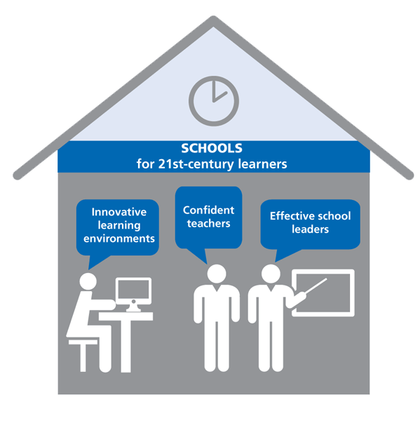
THE IMPACT OF SCHOOL LEADERSHIP
Notes:
If “improving the quality of school leadership is more important than improving the quality of a single teacher’s practice “, then…
it is even more important to examine the critical role of school leadership – and what effective instructional practice and quality formation to fully support school and system leaders looks like...
In the recent OECD/2015 International Summit on the Teaching Profession this year, we are seeing a growing awareness world-wide about the pivotal role of school leadership:
“What schools need to meet these challenges are effective leaders who can make evidence-informed decisions, provide the instructional leadership that teachers need to help their students succeed in school, and create a collaborative school environment in which teachers take part in school decisions.”
ACTIVITY OPTION: BUZZ GROUPS - THE IMPACT OF SCHOOL LEADERSHIP
**AMY TO INTRODUCE ACTIVITY
1/3 – Learning Environments
1/3 – Confident Teachers (What does this look like in Peru?)
1/3 – Effective School Leaders

Slide 37

REFERENCES
Fullan, M. And Quinn, J. (2015) Coherence, Corwin.
(Fullan, M. (2014) Moving from Great to Excellent: Ontario’s Journey, International School Leadership:
www.internationalschoolleadership.com
Fullan, M. (2013). Motion Leadership in Action, Corwin.
Hattie, J. (2015). What works best in education: The politics of collaborative expertise. London, UK: Pearson.
Leithwood, K., Azah, Vera N. (2015) Leading Student Achievement: networks for Learning.
Leithwood, K., Seashore Louis, K., Anderson, S. And Wahlstrom, K. (2004) How Leadership Influences Student Learning, The Wallace Foundation.
Schleicher, A. (2015). Schools for 21st-Century Learners: Strong Leaders, Confident Teachers, Innovative Approaches, International Summit on the Teaching Profession, OECD Publishing.)
Schleicher, A. (2015) Students, Computers and Learning: Making the Connection. OECD Webinar.
Notes:
Let’s look at some of these strategies in a little more detail.
Here is an example of a feedback log where the student self assesses, invites peer assessment, and the teacher comments on the feedback.

Slide 38

CONTACT
INFORMATION
International School Leadership
(A Subsidiary of the Ontario Principals’ Council)
www.internationalschoolleadership.com
Dr. Joanne Robinson
jrobinson@principals.ca

